Slide 1
(CMSC5720-1) MSC projects 2014-5
by Prof K.H. Wong (21 July2014)
khwong@cse.cuhk.edu.hk (shb907)

Slide 2
Project 1: Deep neural network research
Deep neural network research is becoming very popular in the field of artificial intelligence and new and encouraging results have been produced in recently year. Students can study Deep neural networks for applications such as face or object recognition, image or music database search, or cyber security etc.
Application: face recognition , speech recognition, intrusion detection for cyber security
Ref: http://www.fastcolabs.com/3026423/why-google-is-investing-in-deep-learning

Slide 3
Project 2: Computer vision for Google Glasses
  The Google glasses will become popular and should inspire a new generation of computer vision applications. Here are some ideas: (i) Text translation of what the user is looking at. The idea is to develop automatic translation of what the user is seeing. When the user is wearing Google Glasses, what he is seeing is being captured by a camera. Using Optical character recognition (OCR) technology, the machine can translate the foreign texts he/she is looking at into the language he/she understands, then displays using the Google glasses or speak to the user through the earphones. (ii) Tourist Navigation: Using computer vision and GPS technology, the system can display information of the area, advertising materials etc. to the user.
  Reference: http://www.youtube.com/watch?v=JSnB06um5r4&feature=related

Slide 4
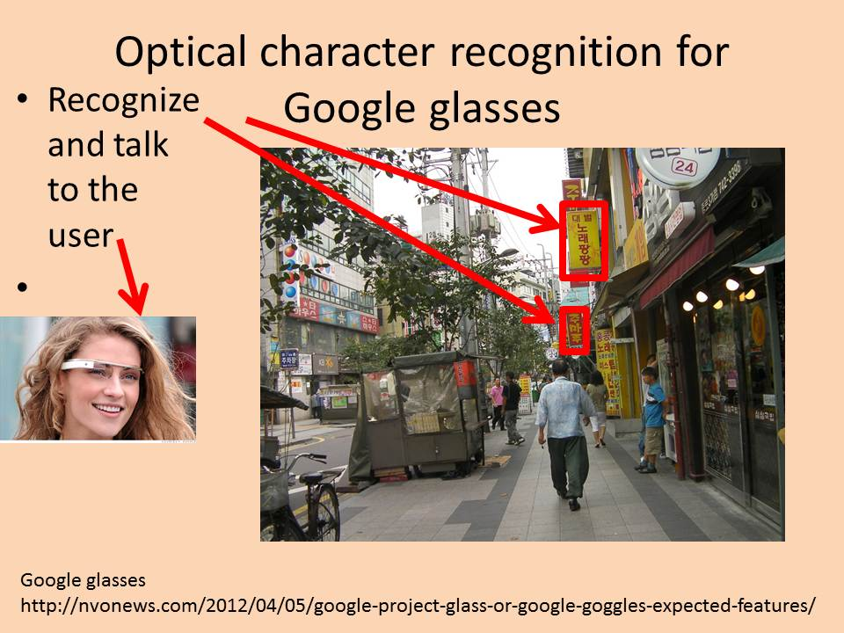

Slide 5
Project 3: Computer music research
Use computer to analysis music signals and the result can be used for various applications. For example:
    Automatic classification of a music recording into different genres: jazz, pop or classical etc.
    Automatic karaoke: to generate and play the piano (or orchestral) accompanying sounds when an instrumental player (e.g. violinist) is playing the solo part.

