Slide 1
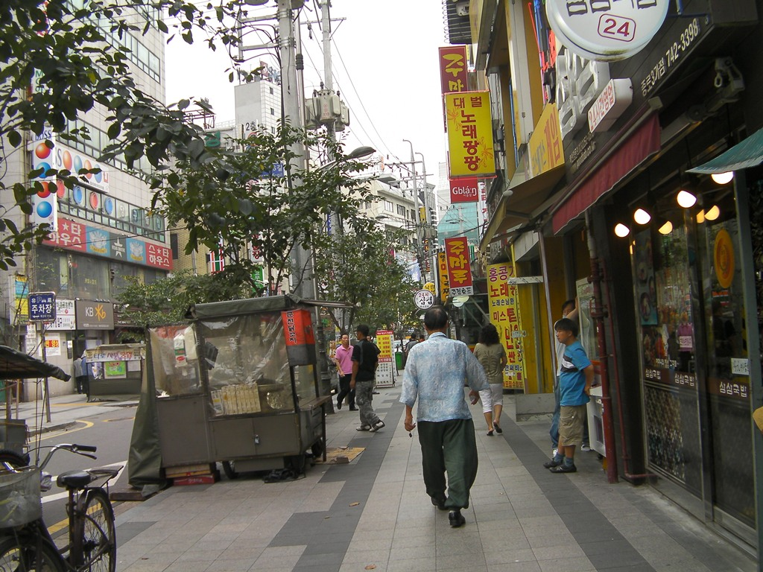
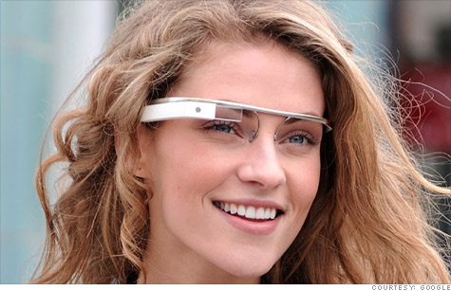
Optical character recognition for Google glasses
Recognize and talk to the user
Google glasses
http://nvonews.com/2012/04/05/google-project-glass-or-google-goggles-expected-features/

