Slide 1
FYP projects for 2017-8
To be supervised by Prof. KH Wong

Slide 2
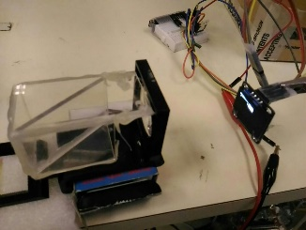
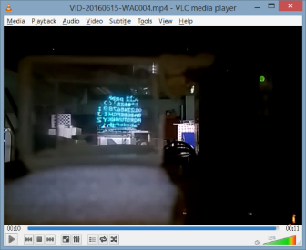
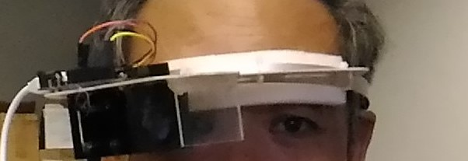
KHW1701 : Smart wearable glasses development (software part) CS+CE
Wearable glasses such as the google glass draws a lot of attention from the public because it provides novel applications to users such as displaying information directly inside the users' normal viewing areas.
We designed a novel wearable glass hardware that has a larger display area and can be built at low cost. The project is to develop software applications such as text recognition, language translation or face recognition for the device. The project is suitable for those who are interested in system development and the creation of new products. We expect the system can be turned into a successful commercial product in future. Ref:
CUGLASS demo: http://www.cse.cuhk.edu.hk/%7Ekhwong/www2/cmsc5711/iv24_smart_glasses.pptx
Face track demo :https://www.dropbox.com/s/xqh4lq2el3tuq0h/Take2.avi?dl=0

Slide 3
KHW1702 : Smart wearable glasses development (hardware part) CE
Wearable glasses such as the google glass draws a lot of attention from the public because it provides novel applications to users such as displaying information directly inside the users' normal viewing areas.
We designed a novel wearable glass hardware that has a larger display area and can be built at low cost. The project is to develop and improve our hardware system, such as incorporating more sensors like IMU (Inertial measurement unit ), GPS into our device.
The project is suitable for those who are interested in system development and the creation of new products. We expect the system can be turned into a successful commercial product in future. Ref:
http://www.cse.cuhk.edu.hk/%7Ekhwong/www2/cmsc5711/iv24_smart_glasses.pptx

Slide 4
KHW1703: Smart watch development (software part) CS+CE
The smart watch is seen as the next computing device that may have impact similar to that of the mobile phones. In this project, we will develop a super smart watch that incorporates a camera that can recognize text , faces etc. There are unlimited features that you can build for this device, the limit is your own imagination.
The software part may concentrate on the use of computer vision and applied Artificial Intelligence A.I. methods to enhance the capability of current smart watch systems. Students may involve the use C++ based OPENCV (http://opencv.org/) and/or a machine learning system DLIB (http://dlib.net/ ) in the project.

Slide 5
KHW1704: Smart watch development (hardware part) CE
The smart watch is seen as the next computing device that may have impact similar to that of the mobile phones. In this project, we will develop a super smart watch that incorporates a camera that can recognize text , faces etc. There are unlimited features that you can build for this device, the limit is your own imagination.
The hardware part may concentrate on using an SOC (System on Chip) development system and add interesting functionality to it. The work may use assembly or C++ program on an ARM processor.

Slide 6
KHW1705: Open FPGA projects CE
Microsoft is investing heavily on FPGA ( Field programmable Gate Array) for its efficiency on computation acceleration. It may be one of the next hot technologies in the computer revolution. Students can propose their projects and work on systems that use our FPGA development system (Zedboard) based on VHDL or Verilog.
Reference: https://www.top500.org/news/microsoft-goes-all-in-for-fpgas-to-build-out-cloud-based-ai/

